Slide 1
CO-HOOTS
CO-WORKING SPACES
Presented by:
Aasavari Kaley
Rujuta Tamhankar
Ajay Deshmukh
Gnanitha Meka

Slide 2


Where are we?
6 Geographical Locations
Santa Clara
San Jose
San Francisco
Palo Alto
Mountain View
Sunnyvale

Slide 3




What do we Offer?
INTERNET FACILITIES
COMPUTER SYSTEMS
TRANSPORTATION SERVICES
PRINTERS

Slide 4


What do we Offer?
Reservation on Daily / Monthly / Yearly basis
Reward Points

Slide 5


BUSINESS VALUE
Reserving spaces through the company website on daily, monthly or yearly basis.
Amenities provided like workstations, Wi-Fi, printers.
Revenue generation from transportation services.
The user reward system encouraging users to book services thus improving sales for the organization.

Slide 6

BUSINESS REQUIREMENTS
Functional - Process Oriented
.Create user profile
Select the office site based on location and size.
Offer default and optional office related services.
Provide transportation facility
Create online payment portal
Allocate user rewards
Manage online platform and datastores

Slide 7
BUSINESS REQUIREMENTS
Functional - Information Oriented
The system should store user credentials, booking history
The system should save the office locations and respective charges.
The system should store the rental details and office related services, transportation services and respective charges.
The datastore should save the data like User Rewards

Slide 8
BUSINESS REQUIREMENTS Non-Functional
Operational - Compatible with multiple O.S, mobile browsers/ hand-held devices, Back-up server
Performance - 24/7 access except for the maintenance period after every 3 months
Security - Spyware and web protection to prevent virus attacks
Cultural and political - Availability in multiple languages, compliance with state and federal laws regarding working & location acquisition.

Slide 9
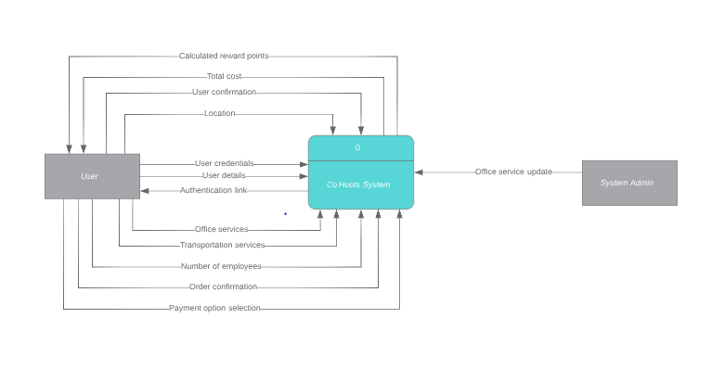
Context Diagram

Slide 10
User Interface

Slide 11


Slide 12
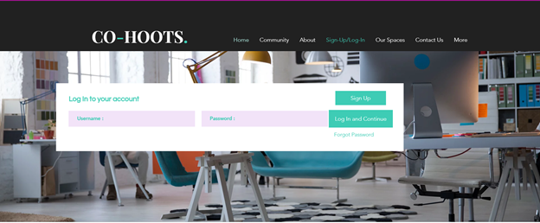

Slide 13
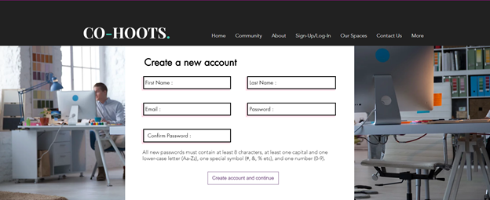

Slide 14


Slide 15


Slide 16
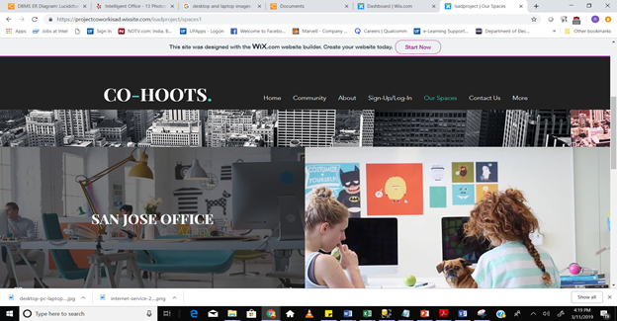

Slide 17
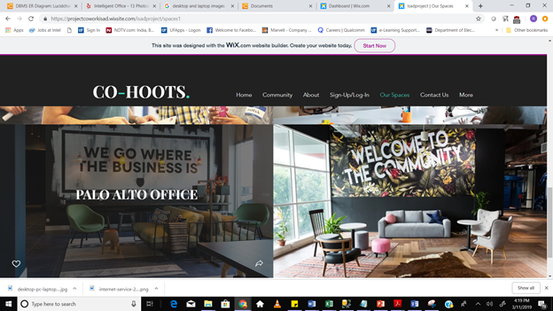

Slide 18
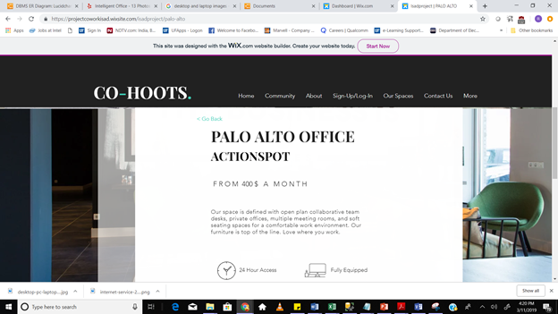

Slide 19
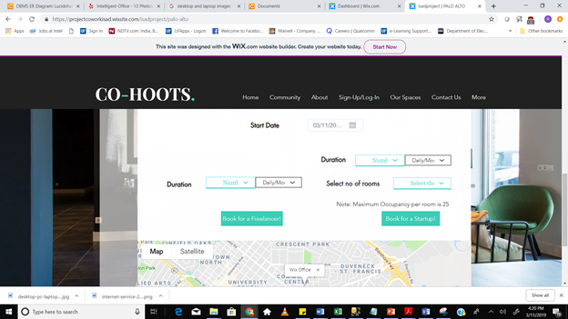

Slide 20
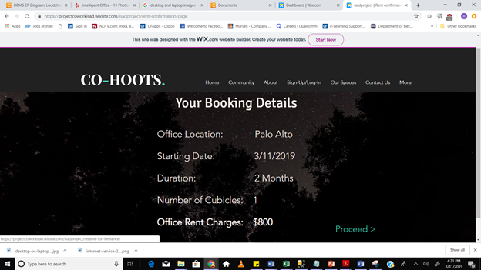

Slide 21
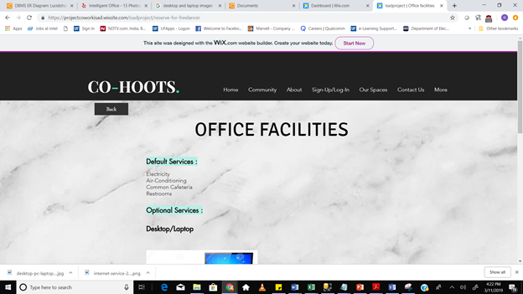

Slide 22
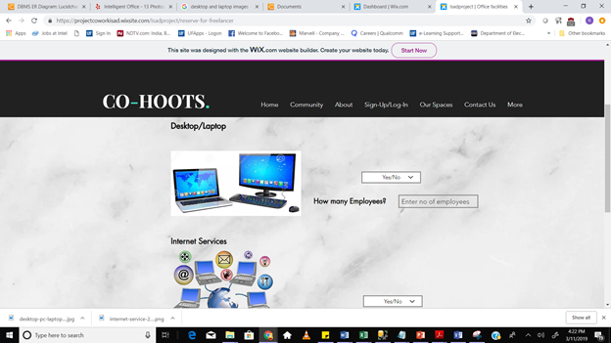

Slide 23
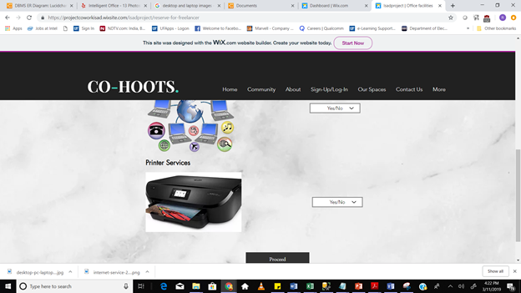

Slide 24
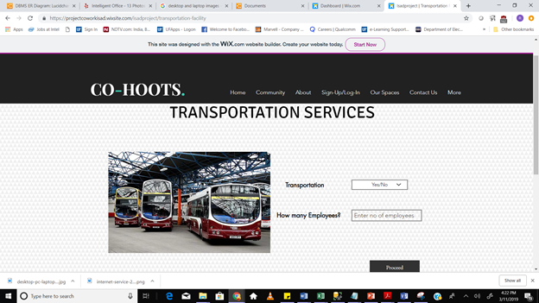

Slide 25
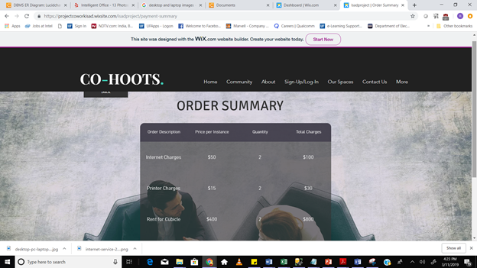

Slide 26
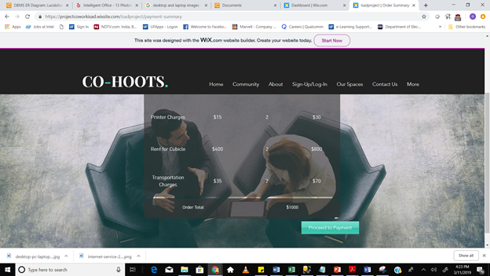

Slide 27
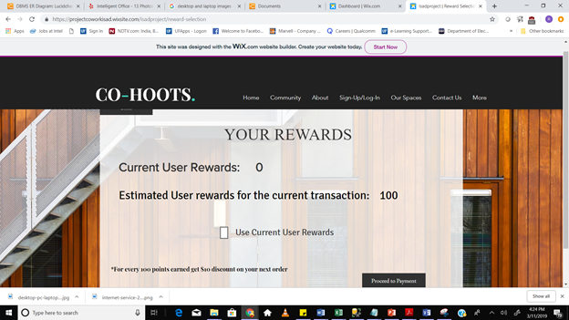

Slide 28
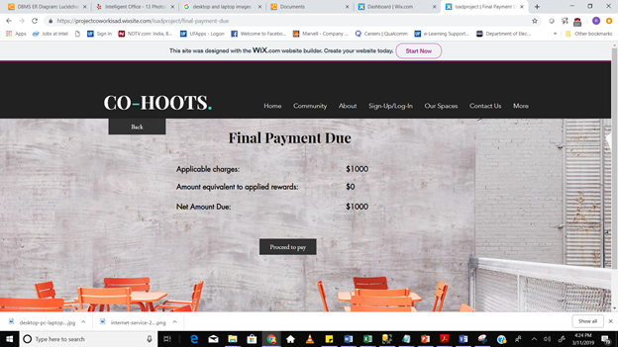

Slide 29
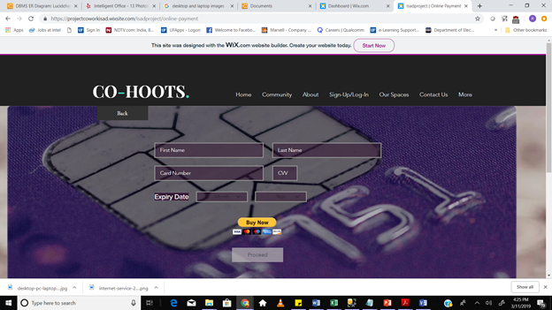

Slide 30
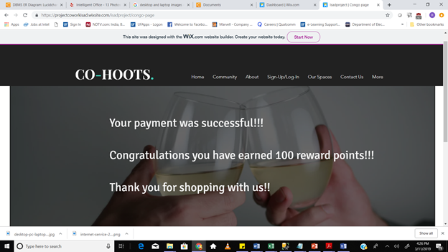

Slide 31
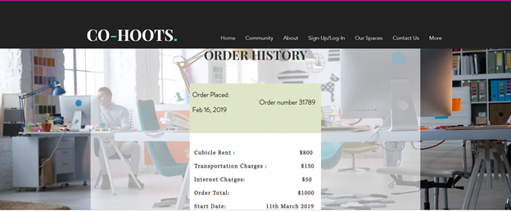

Slide 32
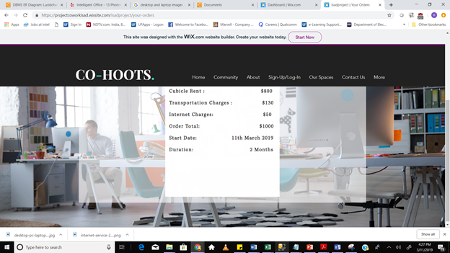

Slide 33
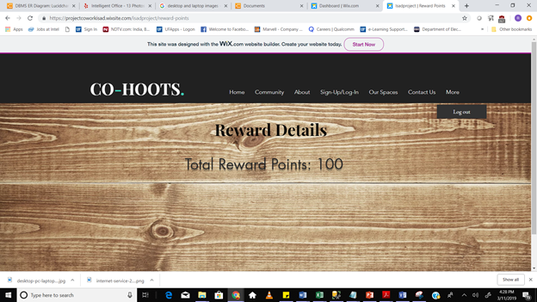

Slide 34
Thanks!
Questions?

